Slide 1

Final Project: Tailoring Tinder Profiles by AGE
IST-652
Section 21980
Joseph Hartman
December 11, 2018

Slide 2
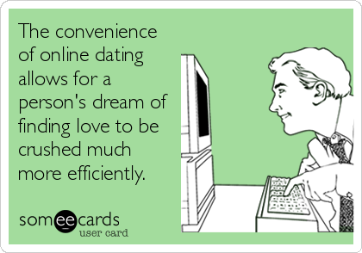
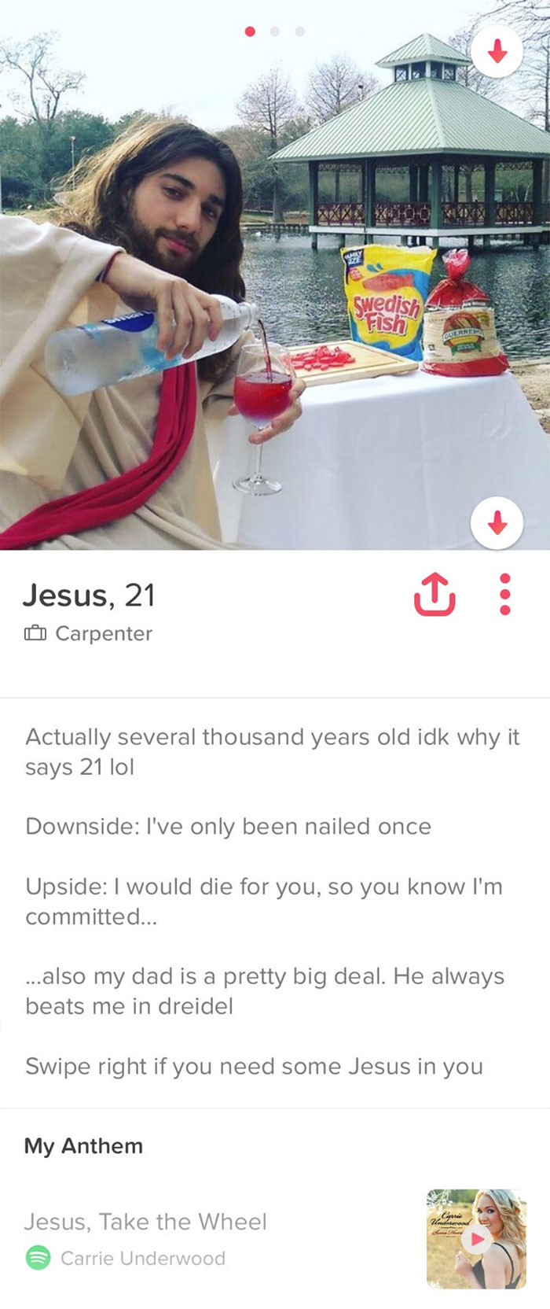
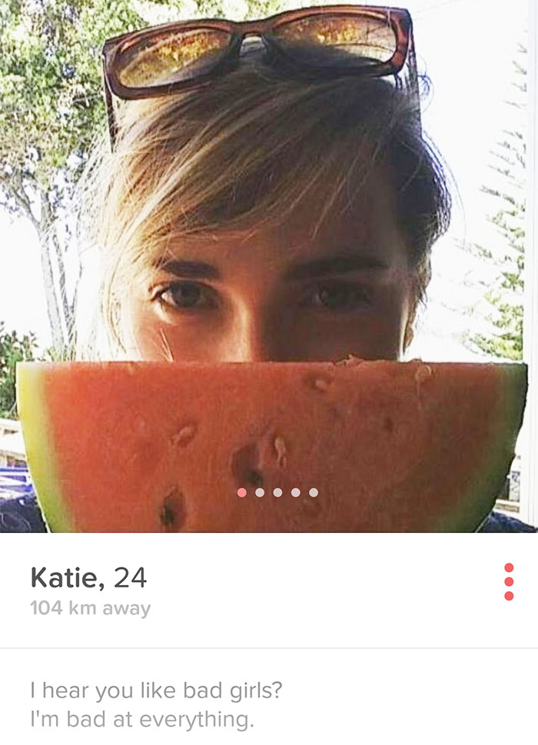
Business Case

Slide 3
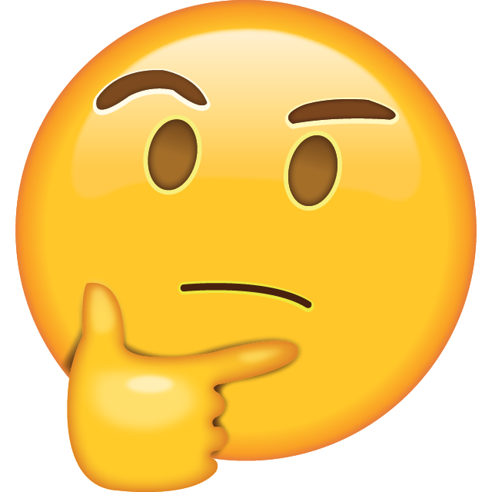
Business Case
Main Objective is to find qualities about a profile that we can used linked to age
Length
Sentiment
Words and/or characters

Slide 4
Business Case
When targeting a particular age or age demographic to date can we determine the ideal biography size and sentiment?
By creating a Naive-Bayes Classifier, can we extract the important words/features that show up depending on the age group of the user so that other users can tailor their biography using similar words to increase right-swiping potential?

Slide 5
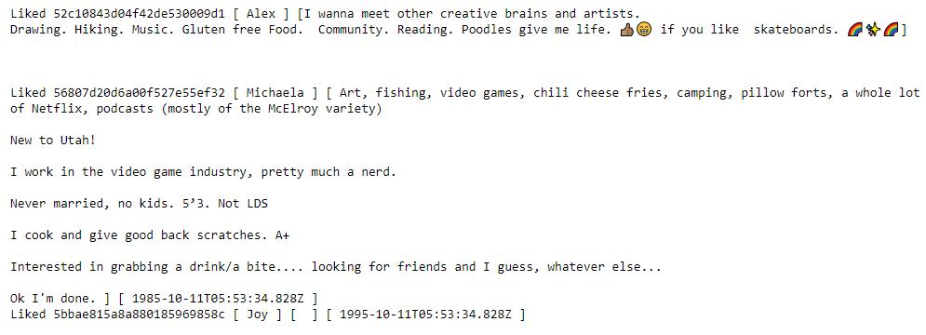

Data Preprocessing

Slide 6
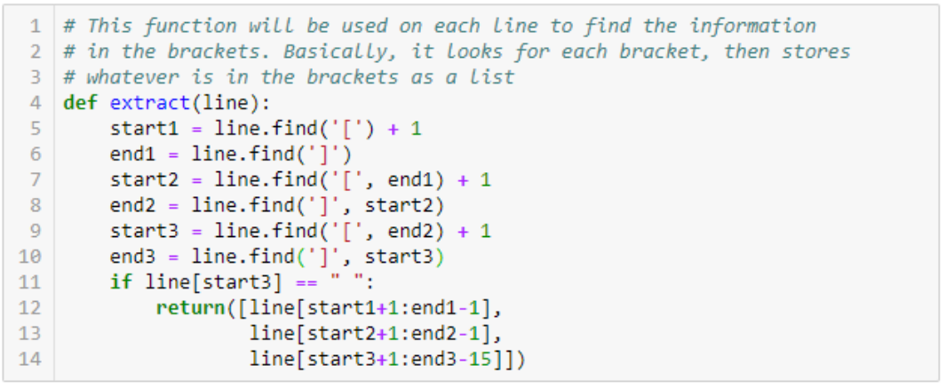

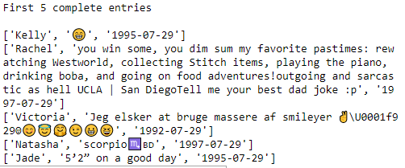
Data Preprocessing

Slide 7
Data Preprocessing

Slide 8
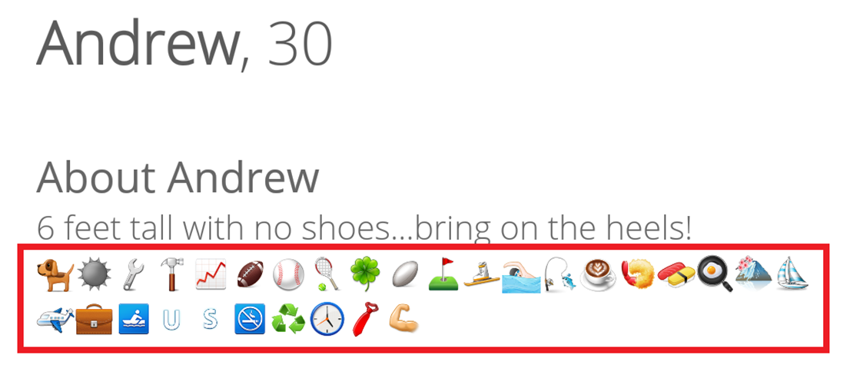
Data Preprocessing
Multiple problems with traditional data pre-processing for NLTK and TextBlob
Data contains international users, approach used for project only works for English
Processing removes punctuation which can remove information e.g reporting height
Processing removes emoticons, shorthand notation for expressing interests, values, sentiment, etc.

Slide 9
Analysis question 1

Slide 10
Analysis question 1
<25: 15 or less unigrams.
30s to 40s: 20 or more unigrams.
No noticeable trend in sentiment

Slide 11
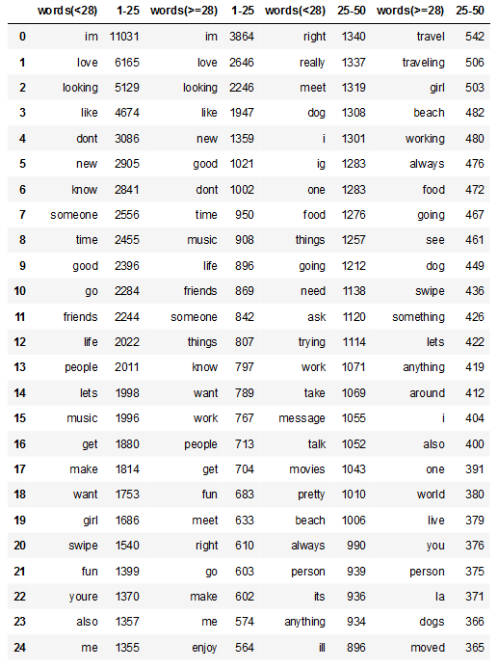
Analysis question 2
First approach is to use FreqDist
Chose a splitting point at 28
<28 → “young”
>=28 → “old”

Slide 12
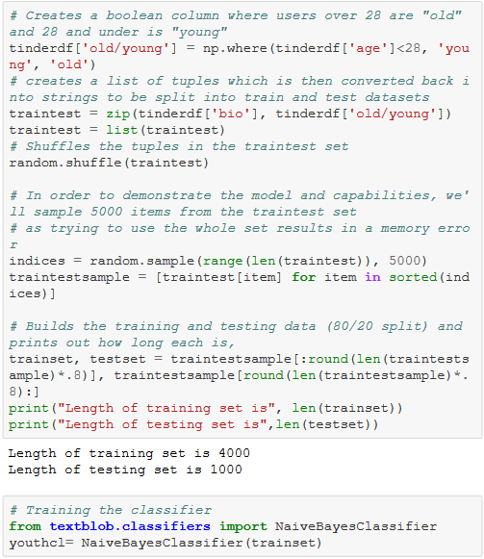
Aq2: Building the Model

Slide 13
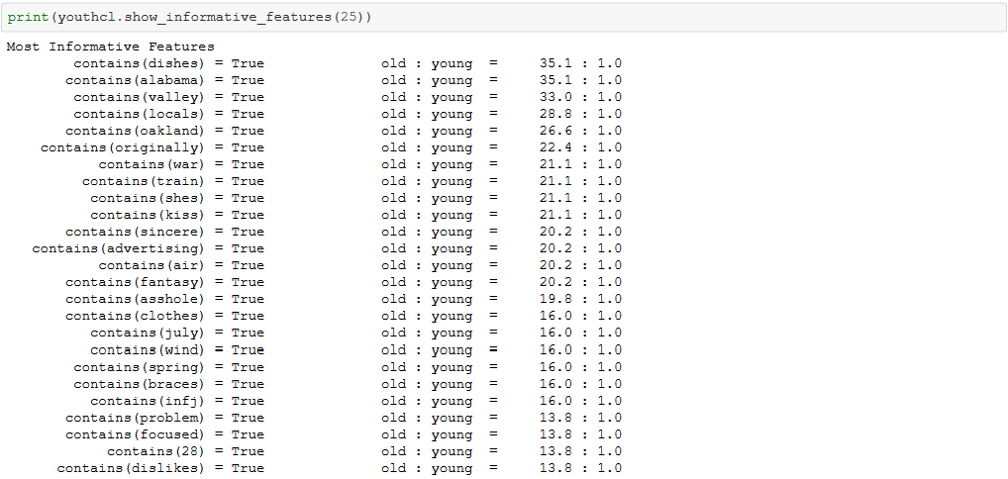
Aq2: Building the Model

Slide 14
Aq2: Building the Model

Slide 15

Aq2: Building the Model
Possible reasons for the problems with Informative Features:
Many of the words that are used by those in "young" are also used by the those in "old“
Words that are rare across the entire dataset of "old" and "young" are more likely to appear amongst those in the "old" group.
Related to the point above, one issue could stem from how TextBlob's classifier works.
"By default, the NaiveBayesClassifier uses a simple feature extractor that indicates which words in the training set are contained in a document. For example, the sentence I feel happy might have the features contains(happy): True or contains(angry): False."

Slide 16
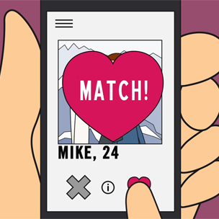
Conclusions
3 main conclusions can be derived from analysis:
Older users tend to have bigger biographies, thus if you're targeting 30-40 age range, add a little more detail about yourself to show that you're putting effort in to finding a match. If not, keep your biographies short and to the point to avoid distancing/boring potential matches.
Sentiment (use of positive or negative language) does not seem to have a noticeable impact except for maybe a slight effect in the "old" group. The effects will probably be minimal but try using more positive language than negative language.
Emoticons seem to be very popular amongst younger users. If targeting this group, use a combination of emoticons and very short, to the point bios.

Slide 17
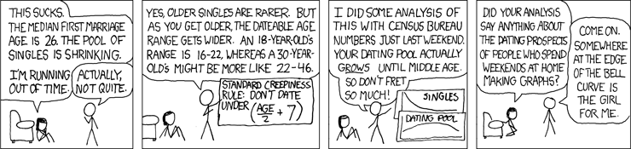
END
https://xkcd.com/314/

